Slide 1

Sant Dnyaneshwar Shikshan Sanstha's
Annasaheb Dange College of Engineering and Technology (ADCET), Ashta
(An Empowered Autonomous lnstitute affiliated to Shivaji University, Kolhapur)
Department of Civil Engineering
2025-26
AirShield: An IoT-Enabled Indoor Air Quality Monitoring and Alert System
Group Members: | Roll Number: | URN:
Sumit Parihar | 24 | 23031138
Barsha Gupta | 25 | 23031139
Akshita Jha | 31 | 23101051
Pranav Bhale | 43 | 23011075

Slide 2
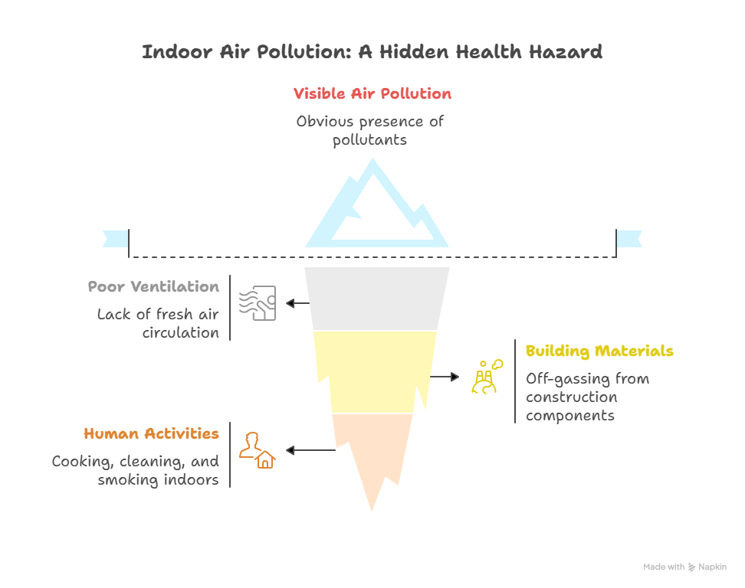
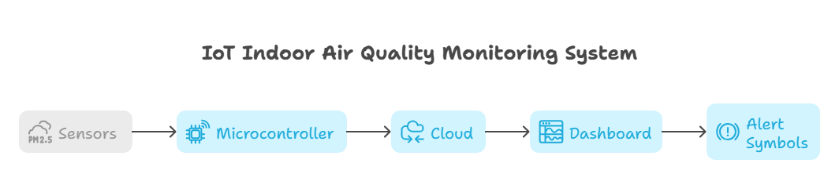
INTRODUCTION
Proposed Solution:
AirShield: An IoT-based system for real-time indoor air quality monitoring.
Monitors CO₂, VOCs, PM2.5, temperature, and humidity.
Provides threshold-based alerts (LED, buzzer, SMS/Telegram).
Visualizes data on an interactive dashboard for quick awareness.
Uniqueness of Solution:
Low-cost and accessible for classrooms, hostels, and offices.
Provides real-time monitoring with simple predictive/alerting capability.
Combines IoT sensors + cloud dashboard + alert system in one compact solution.
Includes simple comfort/health indicator (green/yellow/red) — not just raw values.
Problem:
Indoor air pollution often goes unnoticed.
Causes: CO₂ buildup, VOCs, PM2.5, humidity fluctuations, poor ventilation.
Effects: headaches, fatigue, reduced productivity, respiratory issues.
Existing solutions are often expensive, reactive, or limited to commercial settings.

Slide 3


PROBLEM STATEMENT AND SCOPE OF THE PROJECT
Problem Statement
Scope of the Project
Indoor air quality in educational spaces often deteriorates unnoticed, yet it strongly influences student health, concentration, and academic performance.
Poor ventilation causes a buildup of CO₂, PM2.5, and VOCs — leading to fatigue, headaches, and respiratory issues.
Existing solutions are expensive, reactive, and not suited for small indoor spaces.
There is a need for a low-cost, smart system that monitors and predicts air quality in real time.
The system focuses solely on indoor air quality monitoring for environments like classrooms, hostels, and offices.
It uses low-cost sensors and microcontrollers (ESP32/NodeMCU) to collect and transmit environmental data.
Cloud platforms (e.g., ThingSpeak/Firebase) are used for data storage and retrieval.
Includes a user-friendly dashboard and alert system but does not control hardware like purifiers or HVAC systems

Slide 4
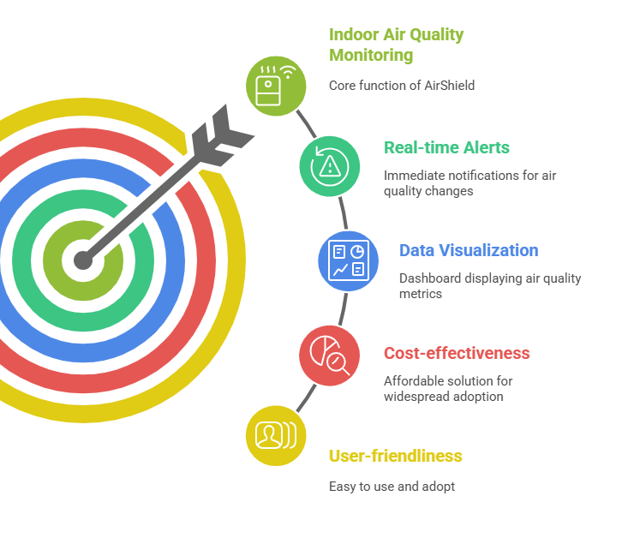
OBJECTIVES
Design and implement
To design and implement AirShield, an IoT-based indoor air quality monitoring system for classrooms, hostels, and small indoor spaces.
Measure
To continuously measure key parameters: CO₂, PM2.5, VOCs, temperature, and humidity.
Provide
To provide threshold-based alerts through LEDs, buzzers, and SMS/Telegram notifications when air quality is unsafe.
Display
To display real-time data and historical trends on an interactive dashboard for easy monitoring.

Slide 5
Progress Till Now
Problem analysis and literature review completed
IAQ parameters finalized
Sensors and hardware selected
System architecture designed
Dashboard concept designed
Cloud platform studied

Slide 6
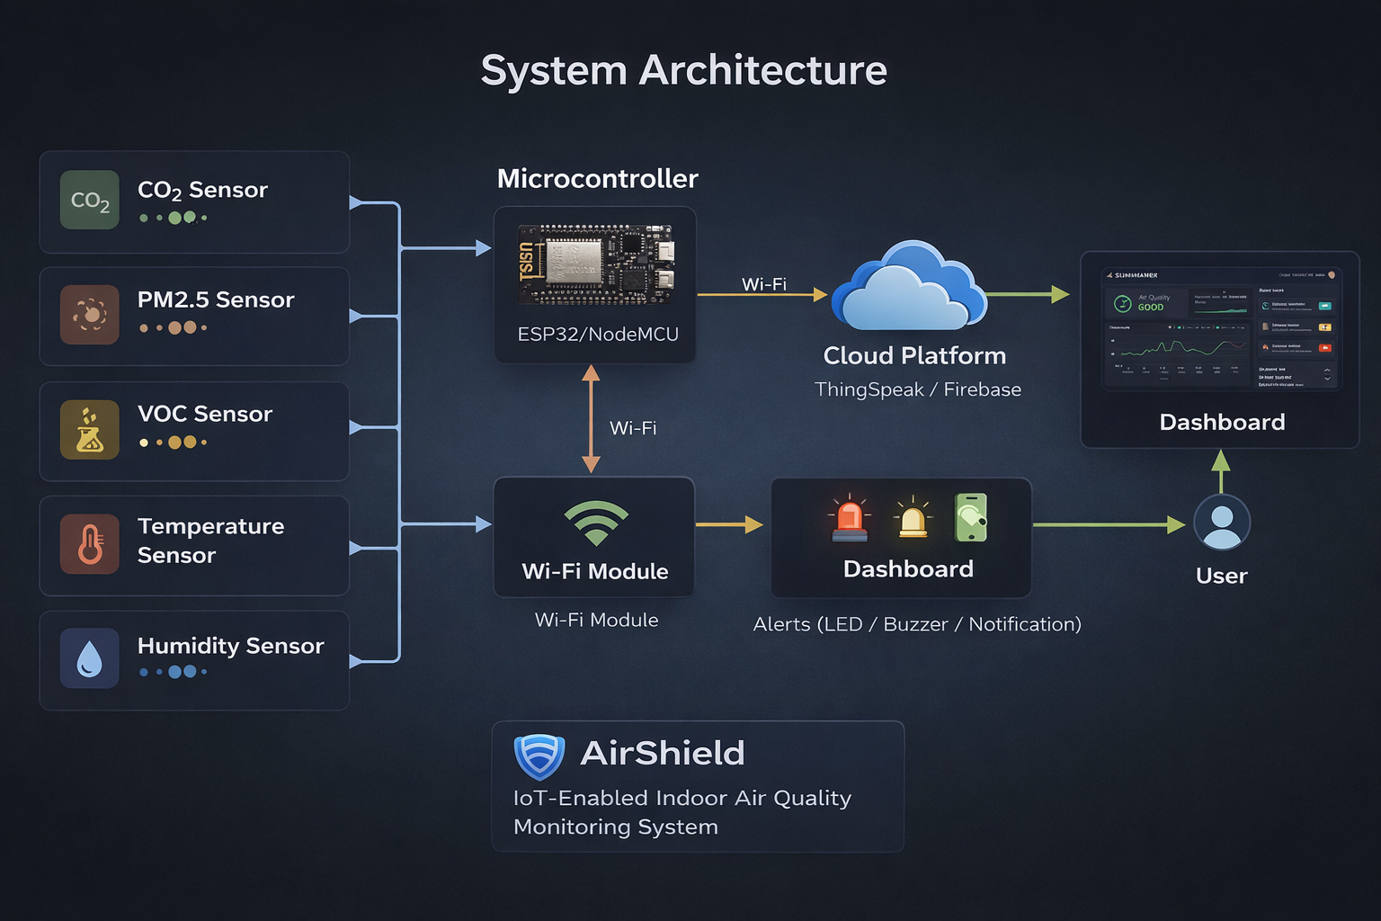

Slide 7
Working Flow
Data Collection Sensors capture air quality
Processing ESP32 processes data
Transmission Data sent to Cloud)
VisualizationDashboard displays data
Alerts Triggered when limits exceed

Slide 8
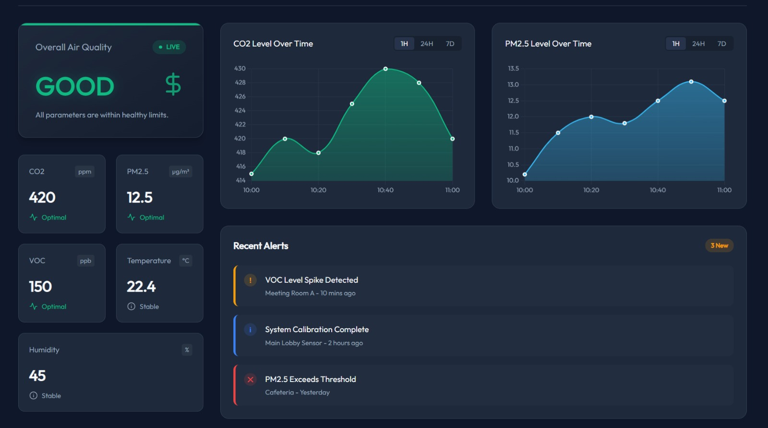
Expected Output/Dashboard
Dashboard Features
Displays air quality parameters (CO₂, PM2.5, etc.)
Health status indication
Graph-based visualization of data
Simple and user-friendly interface
Enables decision-making (e.g., open windows, reduce crowd density)
User Interface
Simple and easy-to-understand layout
Designed for quick awareness

Slide 9
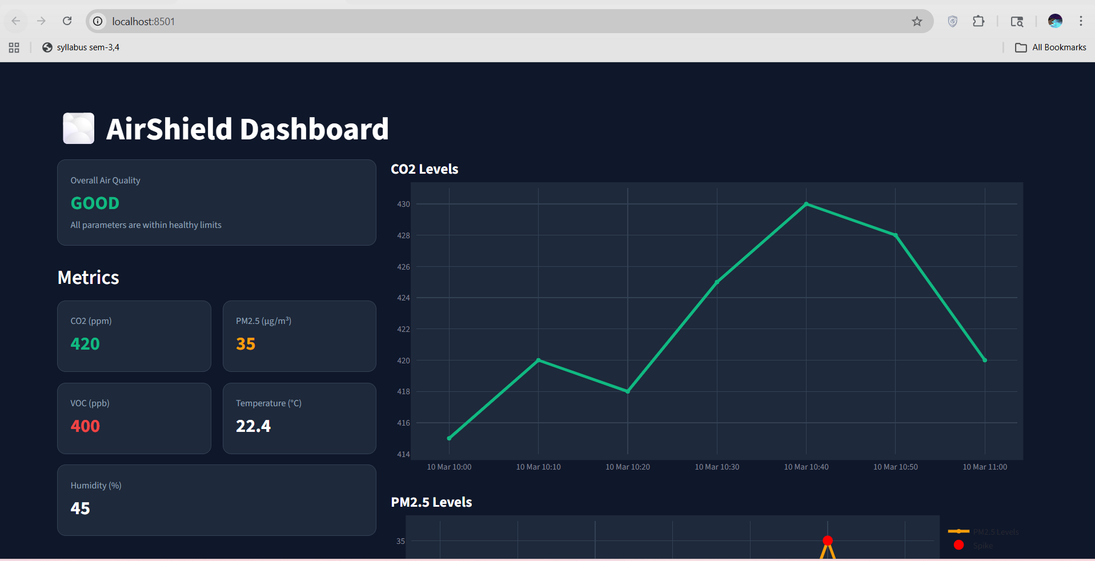
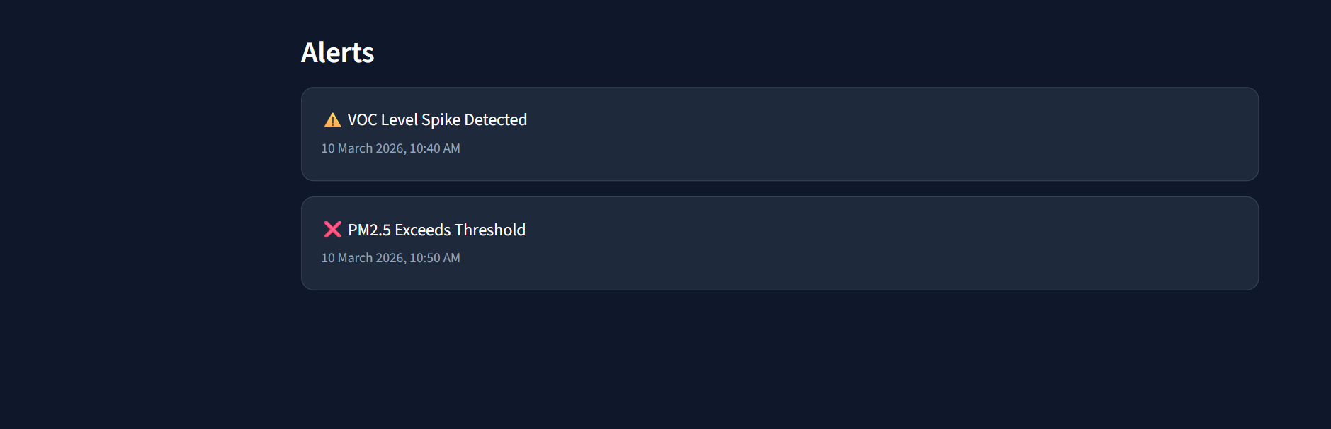
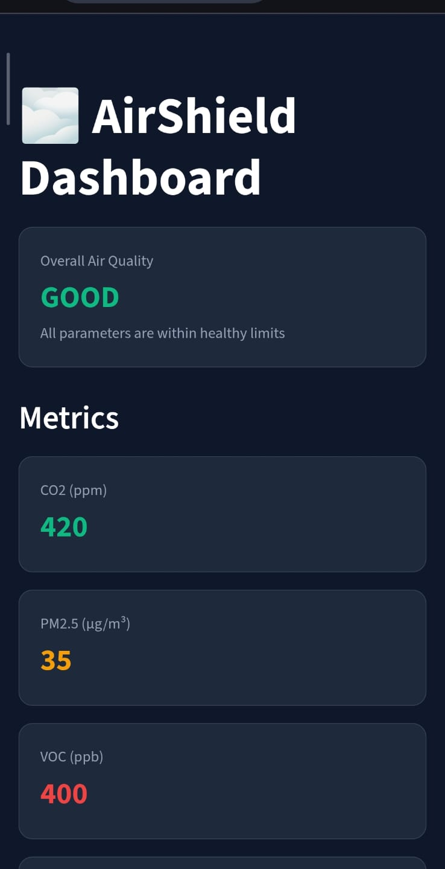
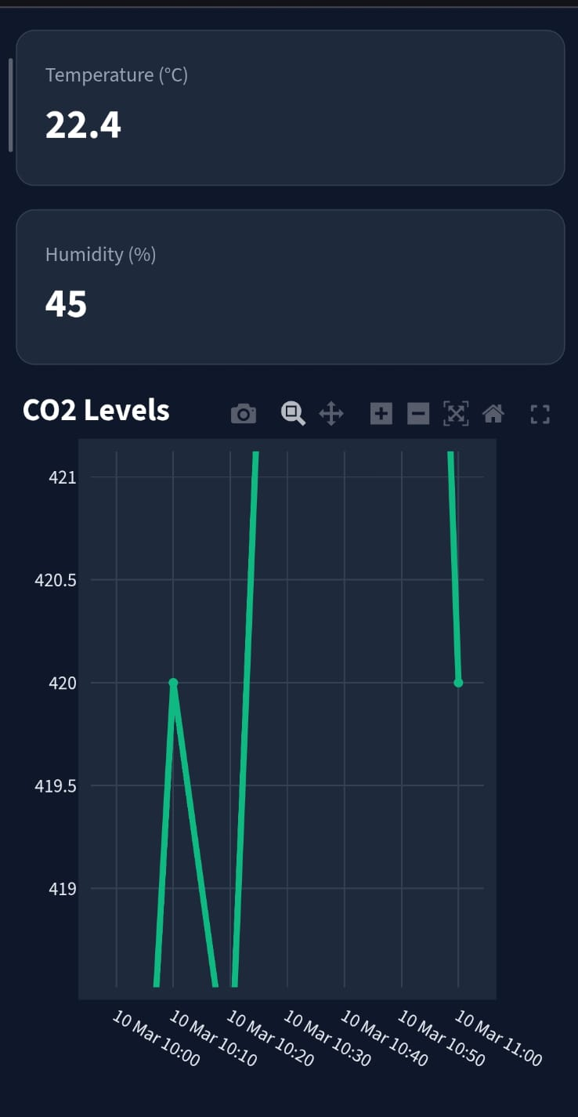
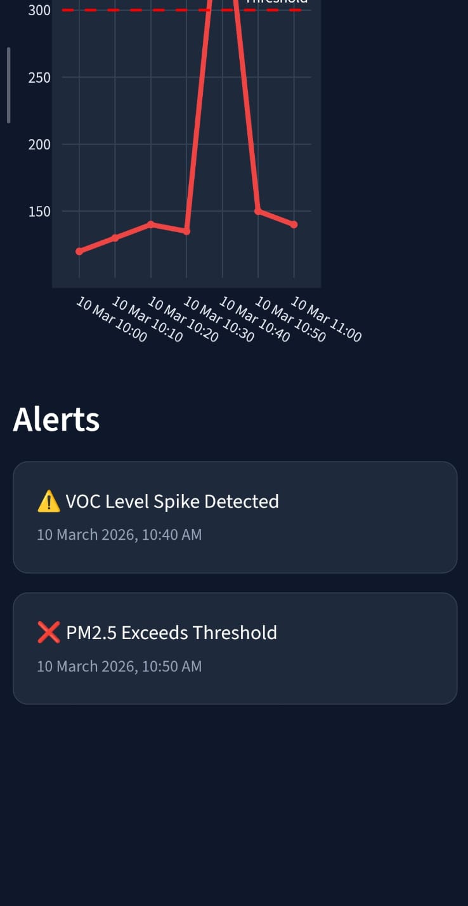
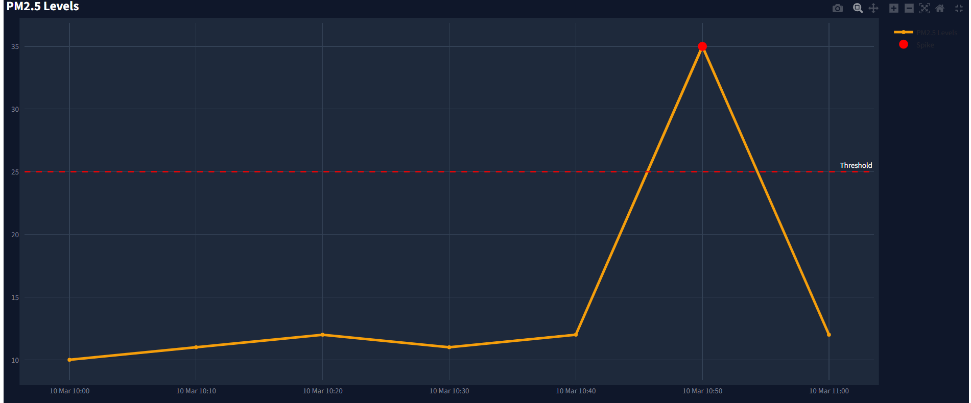
Dashboard Visuals
Alert Notifications**
Dashboard Mock**
Mobile view**

Slide 10
Future Work
Complete sensor integration
Integrate all selected sensors with ESP32
1
Enable real-time data transmission
Transmit sensor data continuously to cloud
2
Connect dashboard with live data
Replace sample data with real-time inputs
3
Implement alert system
Notify users when air quality exceeds limits
4

Slide 11

THANK YOU

